Slide 1
Software Maintenance
Chapter 14

Slide 2
Software Maintenance
Your system is developed…
  It is deployed to customers…
    What next?
Maintenance
  Categories of maintenance tasks
  Major causes of problems
  Reverse engineering
  Management of maintenance activities

Slide 3
IEEE Definition
Maintenance is
  The process of modifying a software system or component after delivery to correct faults, improve performance or other attributes, or adapt to a changed environment.
  More than fixing bugs!
Estimates:
  More than 100 billion lines of code in production in the world
  As much as 80% is unstructured, patched, and badly documented
  Try a monster.com search on “COBOL”

Slide 4
Maintenance Activities
Corrective
  Repair of faults that are discovered
Adaptive
  Modify software to changes in the environment, e.g. new hardware, new OS.
  No change in functionality.
Perfective
  Accommodate new or changed user requirements.
  Changes in functionality.
Preventive
  Activities aimed at increasing maintainability, e.g. documentation, code arrangement.

Slide 5
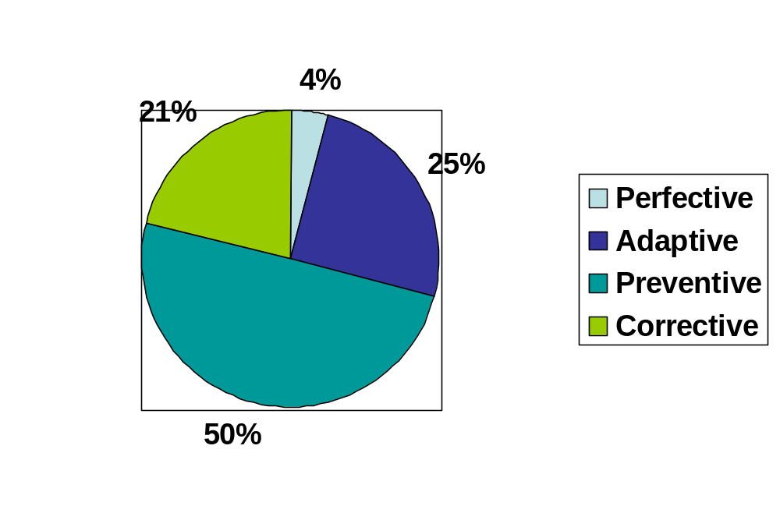
% Effort
Maintenance is also 50% of the total lifecycle costs
Hasn’t changed over the last twenty years – evolution inevitable!

Slide 6
Addressing Maintenance
Higher quality code, better test procedures, better documentation, adherence to standards and conventions
Design for change
Prototyping and fine-tuning to user needs can help reduce perfective maintenance
Write less code
  Reuse

Slide 7
Major Causes of Maintenance
Anecdote by David Parnas on re-engineering software for fighter planes
  Plane has two altimeters
  Onboard software tries to read either meter and display the result
  Code, can be deciphered with a little effort:
    IF not-read1(V1) GOTO DEF1;
    display(V1);
    GOTO C;
    DEF1: IF not-read2(V2) GOTO DEF2;
    display(V2);
    GOTO C;
    DEF2: display(3000);
    C:

Slide 8
Better, Structured Version
If read-meter1(V1) then
display(V1)
else if read-meter2(V2) then
display(V2)
else
display(3000);
endif
But why the number 3000?
Magic Number

Slide 9
Parnas Anecdote
3000:
  Programmer asked fighter pilots what average flying altitude was, used that in case neither altimeter was readable
Re-engineering
  Plane flies high or low, not at average very often, wanted to re-write the code to display a warning instead, e.g. “PULL UP”
  Denied since pilots were trained to react to the default message, even put in the manual: “If altimeter reads 3000 for more than a second, pull up”

Slide 10
Parnas Anecdote
Illustrates major causes of maintenance problems
  Unstructured Code
  Maintenance programmer has insufficient knowledge of the system or application domain
  Documentation absent, out of date, or insufficient
One other:
  Maintenance has a bad image

Slide 11
Laws of Software Evolution
The laws of software evolution also force maintenance to occur
Law of increasing complexity
  A program that is changed becomes less and less structured and thus becomes more complex. One has to invest extra effort in order to avoid the increase in entropy.
Law of continuing change
  A system that is being used undergoes continuing change, until it is judged more cost-effective to restructure the system or replace it by a completely new version

Slide 12
Scant Knowledge Available
Maintenance programmers generally lack detailed knowledge about the system or application domain
  Problem in general, but worse for maintenance
  Often scarce sources available to reference
  Usually requires going to the source code to figure out how the system works
  Experienced programmers have learned to distrust documentation, usually insufficient and out of date
    When a quick-fix is done, the documentation is often not updated to reflect changes

Slide 13
Limited Understanding
Pfleeger:
  47% of software maintenance effort devoted to understanding the software
    E.g. if there are n modules and we change k of them, for each changed module we need to know possible interactions with the other n-1 modules
  >50% of effort can be attributed to lack of user understanding
    Incomplete or mistaken reports of errors and enhancements

Slide 14
Common knowledge problems
A design rationale is often missing
  Why 3000?
  Programmers tend to document how the code works, not the rationale behind the decisions for the code
  Maintenance programmers must reconstruct the decisions and may do so incorrectly
Maintenance Programming in Opportunistic Mode
  Maintenance programmers abstract a structure out of the code based on stereotypical solutions to problems
  If these assumptions are incorrect, the programmer may encounter further problems

Slide 15
Negativity
Maintenance sometimes considered second-rate job
  Goes to inexperienced, one gets promoted to development
  Generally lower salary
  Affects morale, try to change jobs, high turnover
  But maintenance actually requires programmers with the most experience
    Less documentation, often more time pressures, bulk of the lifecycle

Slide 16
Reverse Engineering
The process of analyzing a system to
  Identify the system’s components and interrelationships
  Create representations of the system in another form or at a higher level of abstraction
Akin to the reconstruction of a lost blueprint
Redocumentation
  Derive a semantically equivalent description at the same level of abstraction, e.g. change formatting, coding standards, flowcharts
Design Recovery
  Derive a semantically equivalent description at a higher level of abstraction, e.g. derive UML diagram from source code
  Some tools available to help do this, e.g. Rational Rose

Slide 17
Restructuring vs. Reengineering
Restructuring
  Transformation of a system from one representation to another at the same level of abstraction
  Functionality of system does not change
  Revamping: UI is modernized, spaghetti-like code organized into objects
Reengineering or Renovation
  Real changes made to the system in terms of functions
  Often followed by a traditional forward engineering requirements phase

Slide 18
Maintenance Mindset
Maintenance programmers study the original program code one and a hafl times as long as its documentation
Maintenance programmers spend as much time reading the code as they do implementing a change
Result of the source code being the only truly reliable source of information
How does the programmer study the source?

Slide 19
Maintenance Mindset
Programming plan
  A program fragment that corresponds to a stereotypical action
  E.g. loop to sum a series of numbers, process all elements in an array
Beacon
  A key feature that indicates the presence of a particular structure or operation
  E.g.
    temp = x[i];
    x[i]=x[j];
    x[j]=temp;
If the beacons or plan inherent in the code don’t correspond to the actual design, the maintenance programmer is in for a tough time

Slide 20
Maintenance Strategies
As-Needed
  To maintain a feature, the programmer goes directly to the code for that feature, hypotheses formulated on the basis of local information
Systematic
  An overall understanding of the system is formed by a systematic top-down study of the program text.
  Gives better insight into causal relationships between program components than As-Needed, can better avoid ripple effects

Slide 21
Code Example
What does the following do?
boolean A[][];
…
for i:=1 to n do
for j:=1 to n do
if A[j][i] then
for k:=1 to n do
if A[i][k] thenA[j][k]:=true
endfor
endif
endfor
endfor

Slide 22
Second Example
Mostly incomprehensible code fragment
Procedure A(var x:w)
begin
b(y,n1);
b(x,n2);
m(w[x]);
y:=x;
r(p[x])
end;
Procedure A(var nw: window)
begin
border(current_win, HIGHLIGHT);
border(nw,HIGHLIGHT);
move_cursor(w[nw]);
current_win:=nw;
resume(process[nw]);
end;

Slide 23
Maintenance Organization
Two approaches to maintenance
Throw it over the wall approach
  A new team is responsible for maintenance
  Advantages
    Clear accountability to separate cost and effort for maintenance from new development investment
    Intermittent and unpredictable demands on maintenance make it hard for people to do both
    Separation motivates development team to clean up the code before handoff
    Team can become more specialized on maintenance, service-orientation as opposed to product-orientation, can increase maintenance productivity
  Disadvantages
    Investment in knowledge and experience is lost
    Coordination efforts take time
    Maintenance becomes a reverse engineering challenge
    De-motivation due to status differences
    Possible duplication of communication to users

Slide 24
Maintenance Organization
Mission orientation
  Development team make a long term commitment to maintaining the software
  Reverse advantages/disadvantages of a separate organization for maintenance
Which to use?
  Most express slight preference for separate organization units, with careful procedures to mitigate the disadvantages

Slide 25
Service Perspective to Software Maintenance
Survey of aspects of software quality customers consider most important:
  Service responsiveness
  Service capacity
  Product reliability
  Service efficiency
  Product functionality
Maintenance often can be seen as providing a service to end users as opposed to delivering a product
Should judge maintenance quality differently from development

Slide 26





Services vs. Products
Services are
  Intangible
  Depends on factors difficult to control
    Ability of customers to articulate needs
    Willingness of personnel to satisfy needs
    Level of demand for service
  Produced and consumed simultaneously
    Centralization and mass production difficult
  Perishable
Product vs. Service not clear cut
Pure
Product
Pure
Service
Packaged
Food
Computer
Dealer
Fast
Food
Airlines
Babysitting

Slide 27
Software Product/Service
Continuum for software development and maintenance
Pure
Product
Pure
Service
Shrink
Wrap
Software
Custom
SW Dev
Adaptive
Maintenance
Corrective
Maintenance
Software
Operation

Slide 28
Gap Model
Used to illustrate differences between perceived service delivery and expected services
Gap 1
  Expected service perceived by the service provider differs from the service expected by the customer
  Often caused by service provider focusing on something different than the customer wants, e.g. on features instead of maximum availability
  Customer service expectations should be translated into clear service agreements

Slide 29
Gap Model
Gap 2
  Service specification differs from the expected service as perceived by the service provider.
  E.g. customer expects a quick restart of system in the event of a crash, but service provider is focused on analyzing the reasons
  Would hopefully be caught in a review of service requirements
Gap 3
  Actual service delivery differs from specified services.
  Often caused by deficiencies in human resource policies, failure to match demand and supply, customers not filling their role.
  E.g. not tracking bugs adequately, insufficient staff, customers bypassing help desk to programmers

Slide 30
Gap Model
Gap 4
  Communication about the service does not match the actual service delivery.
  Ineffective management of customer expectations, promising too much, or ineffective horizontal communications.
  E.g. customer not updated on reported bugs
  Can address with bug tracking, helpdesk tools, proper managerial mindset of a customer/service orientation

Slide 31
IEEE 1219
Process for controlling maintenance changes
  Identify and classify change requests
    Each CR is given an tracking ID, classified into a maintenance category
    Analyzed to see if it will be accepted, rejected, further evaluation
    Cost estimate
    Prioritized
  Analysis of change requests
    Decision made which CR’s to address based on cost, schedule, etc.
  Implement the change
    Design, implementation, testing of the change with corresponding new documentation

Slide 32
Reality: Quick-Fix Model
As changes are needed, you take the source code, make the changes, and recompile to get a new version
  Quick and cheap now, but rapidly degrades the structure of the software as patches are made upon patches
  Should at least update docs and higher-level designs after code fixed, but often this is left out, and only done as time permits
  Should only be done for emergency fixes
Non emergency situations
  Planned releases with new versions, change log

Slide 33
Other Models
Iterative enhancement model
  Changes made based on an analysis of the existing system
  Start with highest level document affected by changes, propagate the change down through the remaining documents and code
  Attempts to control complexity and maintain good design
Full-reuse model
  Starts with requirements for the new system, reusing as much as possible
  Needs a mature reuse culture to be successful

Slide 34
Quality Issues
Software quality affects maintenance effort
Should use measurement techniques previously discussed to ensure good quality
Observed trends:
  Studies have found correlations to complexity metrics like Cyclomatic complexity to maintenance efforts
  If certain modules require frequent change or much effort to realize change, a redesign should be given serious consideration

Slide 35
Redesign
When to redesign and reengineer the entire system?
The more of the following you have, the greater the potential for redesign
  Frequent system failures
  Code over seven years old
  Overly-complex program structure and logic flow
  Code written for previous generation hardware
  Very large modules
  Excessive resource requirements
  Hard-coded parameters
  Difficult keeping maintenance personnel
  Deficient documentation
  Missing or incomplete design specs

Slide 36
Summary
Maintenance activities made up of
  Corrective
  Adaptive
  Perfective
  Preventive
Most work spent in Perfective maintenance
Software evolution makes maintenance inescapable
Problems can be mitigated by avoiding poor documentation, unstructured code, insufficient knowledge about the system or design for the maintenance programmers
Maintenance requires a service mentality

